Slide 1
E-Waste Management in Himachal Pradesh
Current Status, Critical Gaps, and Strategic Recommendations
College Classroom Presentation
Presenter: [Your Name]
Course: Environmental Studies & Policy
Notes:
Good morning, professor and classmates. Today, we are going to dive into a critical, yet often invisible, environmental challenge facing our state: Electronic Waste, or E-Waste. Himachal Pradesh is widely celebrated for its pristine mountain landscapes and tourism-driven economy. However, rapid urbanization and digital adoption are generating vast quantities of e-waste. In this presentation, we will analyze the state's official Q3 E-Waste Management Tracker. We will see that while the state has outstanding formal processing facilities downstream, we are facing a critical bottleneck upstream in how we collect and track this waste. I’ll take you through the hard statistics, a major data discrepancy in the official reports, the geographical disparities across our 12 districts, and finally, a concrete roadmap to transition Himachal Pradesh toward a safer, circular economy.

Slide 2
Himachal Pradesh Collects Only 7.7% of Statewide E-Waste
STATEWIDE COLLECTION
7.7%
Only 184,824 kg formally collected out of 2.4M kg generated across the 12 districts.
THE DATA DISCREPANCY
4.8M vs 2.4M
Dashboard reports 4.81M kg generated, but district inventories sum to exactly 2.40M kg.
EPR COMPLIANCE
79.7%
Producers achieved 332,682 kg in collections against the 417,648 kg target.
Analysis of the State E-Waste Flows:
• Extreme Collection Deficit: More than 92% of the generated e-waste escapes the formal regulatory network, leaking into the unmonitored informal sector.
• Critical Data Discrepancy (Academic Alert): High-level dashboard figures are exactly double the sum of the district-wise details (4.81M kg vs 2.40M kg generated; 369.6k kg vs 184.8k kg collected). This implies a duplication in the automated aggregation pipeline, though both yield an identical 7.7% rate.
• Corporate vs. Public Divide: EPR compliance is relatively high (79.7%) but operates in business-to-business silos, failing to reach households.
E-Waste in Himachal Pradesh: Classroom Presentation | State Tracker & Report Analysis
Slide 2
Notes:
Before we examine the policies, let's look at the baseline data. In Himachal Pradesh, our formal e-waste collection rate is a mere 7.7% (or 7.67% from district files). This means more than 92% of the electronics discarded in our state are completely bypassing formal channels. Now, as student researchers, we must point out a glaring mathematical curiosity in the official documents. The high-level operations dashboard reports 4.8 million kilograms of state generation, but if we manually add up the district-by-district breakdown from the same report, we get exactly 2.4 million kilograms—precisely half. This exact 2-to-1 ratio is repeated in the collection figures. This indicates a database duplication or scaling error in the state's reporting database. However, because both datasets yield the exact same 7.7% collection rate, the structural crisis remains identical: the formal take-back system is dry, and the vast majority of our waste is leaking into unmonitored areas.

Slide 3
State Scores 54.2 out of 100 as Upstream Collection Fails Downstream
TOTAL STATE SCORE
54.2
NEEDS IMPROVEMENT
Performance Band: 45 - 64
The State E-Waste Tracker Paradox:
• Extreme System Polarization: The score is not an average of moderate performance. Instead, it represents a direct clash between state-of-the-art facilities and a total absence of formal collection networks.
• Upstream Deficit (0/15 & 0/10): The state fails completely in Generation & Inventory and Informal Sector Integration, receiving flat zero scores in both.
• Downstream Sufficiency (20/20 & 10/10): Authorized recyclers achieve a perfect score for processing capacity and environmental safeguards. The processing pipeline is secure, but remains dry.
E-Waste in Himachal Pradesh: Classroom Presentation | State Tracker & Report Analysis
Slide 3
Notes:
To evaluate how the state is performing as a regulatory unit, we look at the State E-Waste Management Tracker, which scores the state across seven categories. Himachal Pradesh has received an overall score of 54.2 out of 100, placing it in the 'Needs Improvement' category. This average score actually masks an extreme polarization. The state is not doing 'average' across the board. Instead, it is getting perfect scores in recycling capacity and public outreach, but scoring absolute zeroes in collection and informal integration. The system is completely disconnected. We have built world-class recycling facilities, but we have failed to build the physical collection networks to feed them. The pipeline is running dry.

Slide 4
Four Critical Gaps Offset Three Perfect Scores in State Scorecard
Performance Category | Max Weight | Score Earned | Status / Core Observation
Generation & Inventory | 15.0 | 0.0 | Critical Gap: Outdated baseline data
Collection Performance | 20.0 | 2.9 | Critical Gap: Achieved only 8.7% collection
Formal Recycling & Treatment | 20.0 | 20.0 | Optimal: Recycler capacity exceeds targets
Regulatory Compliance | 15.0 | 11.3 | Adequate: Solid producer registration rates
Informal Sector Integration | 10.0 | 0.0 | Critical Gap: Zero scrap dealer formalization
Environmental & Health Safeguards | 10.0 | 10.0 | Optimal: Certified recyclers operate safely
Awareness & Outreach | 10.0 | 10.0 | Optimal: Active public outreach campaigns
E-Waste in Himachal Pradesh: Classroom Presentation | State Tracker & Report Analysis
Slide 4
Notes:
Let's look at the scorecard breakdown. The 100 points are distributed across seven areas. Under the strengths, we see perfect scores of 10 out of 10 for Environmental Safeguards and Awareness, and a perfect 20 out of 20 for Formal Recycling. This means our authorized recyclers operate very safely and have massive capacities—achieving 311% of their recycling target. However, look at the critical gaps. We score a flat zero in Generation & Inventory because our data is completely outdated, and we score a flat zero in Informal Sector Integration. Furthermore, our Collection Performance is critically low at just 2.9 out of 20 because our real collection is a tiny fraction of our 60% target. This scorecard proves that we are failing at the front-end of the pipeline. We have the 'exit' secured, but the 'entrance' is blocked.

Slide 5
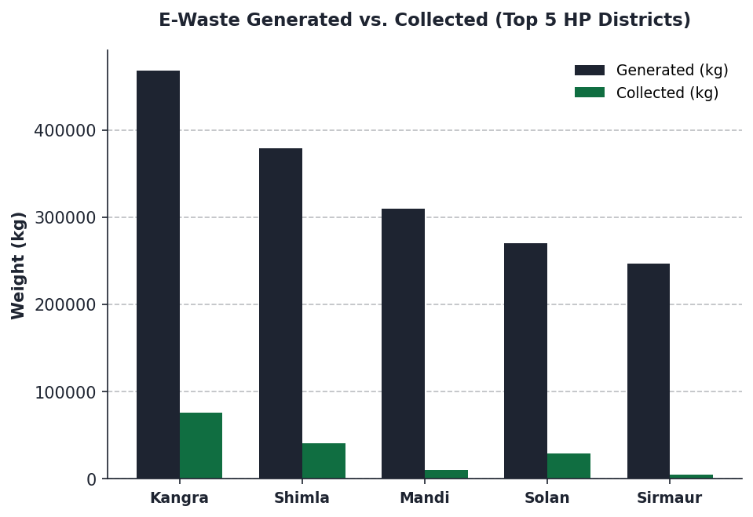
Kangra, Shimla, and Solan Generate 46% of E-Waste but Collect Under 16%
District | Generated | Collected | Rate | Centers
Kangra | 468,124 | 75,504 | 16.13% | 3.0
Shimla | 378,514 | 40,700 | 10.75% | 3.0
Mandi | 309,931 | 9,998 | 3.23% | 1.0
Solan | 269,849 | 29,016 | 10.75% | 3.0
Sirmaur | 246,383 | 5,299 | 2.15% | 1.0
E-Waste in Himachal Pradesh: Classroom Presentation | State Tracker & Report Analysis
Slide 5
Notes:
When we look at the district-level data, the geographical inequality is startling. E-waste generation is heavily concentrated in high-population and urbanized districts. Kangra is our highest generator, producing over 468,000 kilograms of e-waste, followed closely by Shimla and Mandi. But let's look at the collection rates. Even in Kangra, which boasts the state's highest collection rate, we only collect 16.1%. Shimla and Solan only capture 10.7%. And in major districts like Mandi and Sirmaur, collection drops to a shocking 3.2% and 2.1% respectively. This means in Sirmaur, almost 240,000 kilograms of e-waste escape into the environment or the informal sector every year. The data confirms that our formal collection system is failing where the volume is highest.

Slide 6
Nine of Fifteen Collection Centers Cluster in Three Districts, Leaving Others Dry
HIGH ACCESS AREAS
3.0 centers per district
Districts: Solan, Kangra, Shimla
• 9 Total Centers (60% of state total)
• Clustered around industrial & administrative hubs.
• Collection rates are higher (10.7% - 16.1%) but still far below state environmental targets.
LOW ACCESS AREAS
1.0 center per district
Districts: Mandi, Sirmaur, Una, Chamba, Hamirpur, Kullu
• 6 Total Centers (1 center each)
• Serves vast populations with single centers.
• Critical Collection Failure: collection rates drop to 2.1% - 3.2% as physical distance prevents public participation.
ZERO ACCESS AREAS
0.0 centers per district
Districts: Bilaspur, Kinnaur, Lahaul & Spiti
• 3 Total Districts (0 centers)
• Zero physical collection points.
• In extreme, rugged mountainous terrain (e.g. Lahaul & Spiti), residents have absolutely no formal way to dispose of electronic waste.
E-Waste in Himachal Pradesh: Classroom Presentation | State Tracker & Report Analysis
Slide 6
Notes:
Why are our collection rates so low? The answer is simple: lack of physical infrastructure. The entire state has only 15 registered collection centers for 12 districts. If we look at where they are, we see severe geographical clustering. Nine of these centers are crammed into Solan, Shimla, and Kangra. On the other hand, six districts have only a single center, and three districts—Bilaspur, Kinnaur, and the remote Lahaul & Spiti—have absolutely zero registered centers. In a highly mountainous state with rugged terrain, we cannot expect a citizen in Kinnaur or Lahaul to travel hours to dispose of a mobile phone or laptop. Without local, convenient collection points, the formal system is physically inaccessible to half of the state's population.

Slide 7
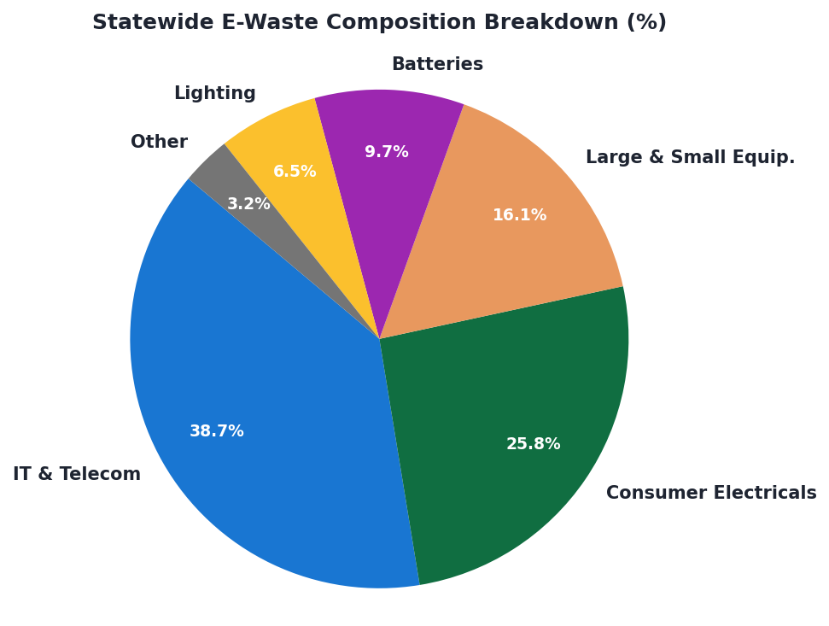
IT and Telecom Products Make Up 64.5% of Electronic Waste
Composition Profile and Risks:
• Dominated by High-Tech Consumption: IT & Telecom equipment makes up 38.7% of the total waste, and Consumer Electronics adds another 25.8%. Together, these account for 64.5%.
• Highly Lucrative Materials: Circuit boards and cables in this segment are highly valuable, containing copper, aluminum, and trace gold. This high market value drives the active informal scrap market.
• Severe Toxic Hazard: This same 64.5% contains heavy-metal toxic substances (lead, mercury, cadmium). If dismantled using backyard methods, it results in long-term environmental contamination.
E-Waste in Himachal Pradesh: Classroom Presentation | State Tracker & Report Analysis
Slide 7
Notes:
To design effective recycling solutions, we must understand what is actually in our e-waste stream. The data reveals that IT and Telecom equipment makes up 38.7% of our waste, and Consumer Electronics adds another 25.8%. Together, these two categories represent nearly two-thirds of the entire waste flow. This is a critical point. These devices are highly lucrative because they contain valuable materials like gold, silver, copper, and aluminum. However, they are also hazardous, packed with toxic heavy metals like lead, mercury, and cadmium. If these electronics are dismantled in open fields or backyards, these toxic chemicals leach directly into our soil, contaminating the mountainous water systems that supply millions downstream.

Slide 8
Zero Score in Informal Integration Pushes Scrap into Backyard Dismantling
STAGE 1: HYPERLOCAL COLLECTION
Informal scrap dealers ('Kabadiwalas') collect the vast majority of household e-waste door-to-door, completely bypassing the 15 registered, formal collection centers.
STAGE 2: HAZARDOUS PROCESSING
Because scrap dealers have zero formal training or regulatory support, they dismantle electronics in non-industrial residential areas using open cable burning and crude acid baths.
STAGE 3: TOXIC DISPOSAL
Acid residue and heavy metals are dumped directly into soil, contaminating pristine Himalayan water systems. Scrap workers face critical health hazards from toxic fumes.
TRACKER SCORE FOR INFORMAL SECTOR INTEGRATION: 0.0 / 10.0
Banning scrap dealers does not stop e-waste leakage. They are the actual logistics backbone of state collection. Integrating them formally is the single most urgent task.
E-Waste in Himachal Pradesh: Classroom Presentation | State Tracker & Report Analysis
Slide 8
Notes:
Our zero score in informal sector integration is perhaps the most critical social and environmental failure in the tracker. In the real world, the formal collection centers are bypassed because local scrap dealers, or 'Kabadiwalas,' have a massive, hyper-local collection reach. They go door-to-door. However, because they are entirely unintegrated and unregulated, they process these electronics using highly hazardous methods. They burn plastic cables in the open to extract copper, and bathe circuit boards in highly toxic acid to extract gold. This exposes workers to lethal fumes and dumps acid wastes directly into the ground. We cannot solve this crisis by ignoring or banning these informal collectors; they are the actual logistical backbone of collection. We must integrate them.

Slide 9
Producers Achieve 79.7% of Compliance Targets in Corporate Silos
REGULATORY REGISTRATION & SCORE
• Compliance Score: 11.3 / 15.0 ('Adequate' status). Represents 75.0% performance of targets.
• Registered Compliant Entities: 10 major manufacturers are formally registered in the state database.
• Corporate Focus: These producers succeed because they focus on corporate offices and bulk consumers, completely ignoring municipal household waste.
EPR COLLECTION PERFORMANCE
• EPR Collection Target: 417,648 kg
• EPR Collection Achieved: 332,682 kg
• Compliance Achievement Rate: 79.7%
• Policy Insight: EPR targets are highly effective in controlled commercial environments, but fail to resolve the public consumer collection challenge.
E-Waste in Himachal Pradesh: Classroom Presentation | State Tracker & Report Analysis
Slide 9
Notes:
Now let's look at Extended Producer Responsibility, or EPR. This is the legal framework that mandates electronics manufacturers to collect back a percentage of the electronics they sell. On paper, this is one of our strongest performers, earning 11.3 out of 15 points. The state's 10 registered producer entities collected nearly 333,000 kilograms of waste against a target of 417,000 kilograms. This is a respectable 79.7% achievement rate. However, there is a structural catch. The EPR framework operates almost entirely in corporate silos. It is highly effective for taking back bulk IT equipment from large offices, but it is completely disconnected from municipal systems. The average household consumer has no access to this EPR channel, meaning household e-waste continues to leak into the informal scrap sector.

Slide 10
Four Structural Blockages Starve State-of-the-Art Recyclers
1. ZERO UPSTREAM CONVENIENCE
There are no municipal ward e-waste drop-off bins or mandatory point-of-sale retail take-back programs, leaving citizens with zero formal avenues for disposal.
2. THE INVENTORY DATA BLINDSPOT
HP scores a flat 0/15 in Generation & Inventory. Multipliers are outdated and based on generic populations rather than localized mountain sector data.
3. EXTREME INFRASTRUCTURE CLUSTERING
60% of registered collection centers are clustered in Solan, Shimla, and Kangra. Remote mountain districts like Kinnaur or Lahaul & Spiti have zero centers.
4. EXCLUSION OF THE INFORMAL SECTOR
HP scores a flat 0/10 in informal integration. Treating Kabadiwalas as illegal entities pushes them into residential backyard processing instead of formal routes.
E-Waste in Himachal Pradesh: Classroom Presentation | State Tracker & Report Analysis
Slide 10
Notes:
To design effective solutions, we must synthesize the root causes of our mediocre 54.2 performance score. First, we have a total lack of front-end convenience; citizens simply have no place to drop off their old electronics. Second, we are operating in a data vacuum, setting policy using outdated population multipliers because we haven't conducted a baseline inventory survey in years. Third, we have severe geographic inequality; our physical collection centers are clustered in industrial and administrative hubs, ignoring our rural and mountainous districts. And finally, our policies exclude the informal sector, pushing 'Kabadiwalas' into the shadows where they continue to process waste using highly hazardous, crude techniques. This is why our system is broken.

Slide 11
Three Strategic Pillars Bridge the Collection and Data Gap
PILLAR A: PHYSICAL INFRASTRUCTURE
Targeting Collection Deficits
• Mandate Local Urban Bodies (ULBs) to establish at least one permanent e-waste drop-off bin in every municipal ward.
• Partner with major retail chains and electronics brands to implement mandatory retail take-back counters (point-of-sale collection).
PILLAR B: INFORMAL SECTOR INTEGRATION
Targeting Zero Scrap Score
• Create a formal digital registration portal for Kabadiwalas, providing protective gear and financial incentives.
• Launch state-funded skill-development programs to train informal scrap dealers in safe dismantling techniques and redirect materials to formal recyclers.
PILLAR C: DATA TRANSPARENCY & TRACKING
Targeting 0/15 Inventory Score
• Implement a mandatory digital reporting ledger for all bulk consumers (government, IT parks, hospitals) to file annual disposal records.
• Conduct a statewide physical survey to update multipliers for mountain populations.
E-Waste in Himachal Pradesh: Classroom Presentation | State Tracker & Report Analysis
Slide 11
Notes:
Our recommendations address these root causes by focusing on three areas: physical infrastructure, social integration, and digital data. First, we must make formal collection convenient by mandating Local Urban Bodies to place drop-off bins in every municipal ward and enforcing retail take-back programs. Second, we must integrate the informal sector. Instead of trying to eliminate 'Kabadiwalas,' we should register them, train them in safe handling, and offer financial incentives to route their collected waste directly to authorized formal recyclers. Finally, we must establish data transparency by launching a mandatory digital ledger for bulk consumers and conducting a fresh state-wide survey to update our baseline numbers.

Slide 12
HP Can Transition to a Model Mountain Circular Economy
THE DOWNSTREAM-UPSTREAM BOTTLENECK
• Recycler Capacity (20/20): High-quality downstream processing and certified treatment centers exist in industrial zones.
• Collection Infrastructure (2.9/20): The processing facilities are running dry because the physical collection pathways are absent.
• The Solution: Connecting the exit with an accessible entrance by building convenient municipal and retail collection portals.
ROADMAP TO A CIRCULAR MOUNTAIN ECOSYSTEM
• Convenient Collection: Widespread municipal ward bins and point-of-sale retail drop-offs.
• Informal Formalization: Converting unregulated scrap dealers into safe, financially incentivized collection partners.
• Digital Accountability: Standard digital ledgers to eradicate data double-counting and target environmental policies effectively.
E-Waste in Himachal Pradesh: Classroom Presentation | State Tracker & Report Analysis
Slide 12
Notes:
In conclusion, the story of e-waste in Himachal Pradesh is not one of a total system failure. It is a story of a disconnected pipeline. The state has already done the hardest part: it has built optimal, high-quality downstream recycling facilities. But these facilities are running dry because our collection systems are broken. By implementing convenient ward-level drop-off bins, establishing digital tracking, and converting informal scrap dealers into formal green jobs, Himachal Pradesh can turn this environmental hazard into a thriving, safe circular economy. This is our roadmap to take the state from a mediocre 54.2 score to a sustainable, model mountain state. Thank you, and I am happy to take any questions!

